Slide 1
Discourse Based Mathematics: Using Discussion and PBL for Deeper Understanding
Presented by:
Gregory L. Taylor, Ed.D.

Slide 2
The Brain and Math Learning

Slide 3
Is MATH a sorting machine?
Our culture has favored a role for mathematics as a “sorting mechanism” used to develop indicators toward knowing who is GIFTED.

Slide 4
Is MATH a sorting machine?
Our culture has favored a role for mathematics as a “sorting mechanism” used to develop indicators toward knowing who is GIFTED.
There is an imperative need for mathematics to change from an “ELITIST” performance subject used to rank and/or sort students…

Slide 5
Is MATH a sorting machine?
Our culture has favored a role for mathematics as a “sorting mechanism” used to develop indicators toward knowing who is GIFTED.
There is an imperative need for mathematics to change from an “ELITIST” performance subject used to rank and/or sort students…
to an OPEN LEARNING subject.

Slide 6
Activity 1
Activity 1

Slide 7
Activity 1
Do these WITHOUT using the standard ALGORITHM:
Group 1: 18 x 5
Group 2: 12 x 15
Group 3: 17 x 33
Group 4: 9 x 22

Slide 8
Activity 1
Do these WITHOUT using the standard ALGORITHM:
Group 1: 18 x 5
Group 2: 12 x 15
Group 3: 17 x 33
Group 4: 9 x 22

Slide 9
The Power of Mistakes and Struggle

Slide 10
The Power of Mistakes and Struggle
Every time we make a mistake…

Slide 11
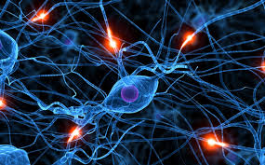
The Power of Mistakes and Struggle
Every time we make a mistake… …we grow a synapse

Slide 12
The Power of Mistakes and Struggle
Even when we are completely unaware we are making a mistake…

Slide 13
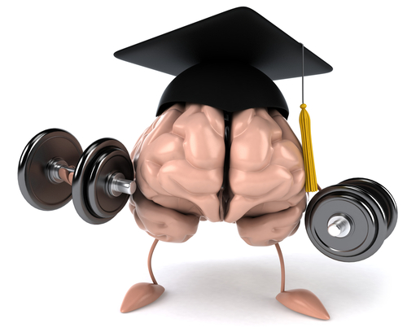
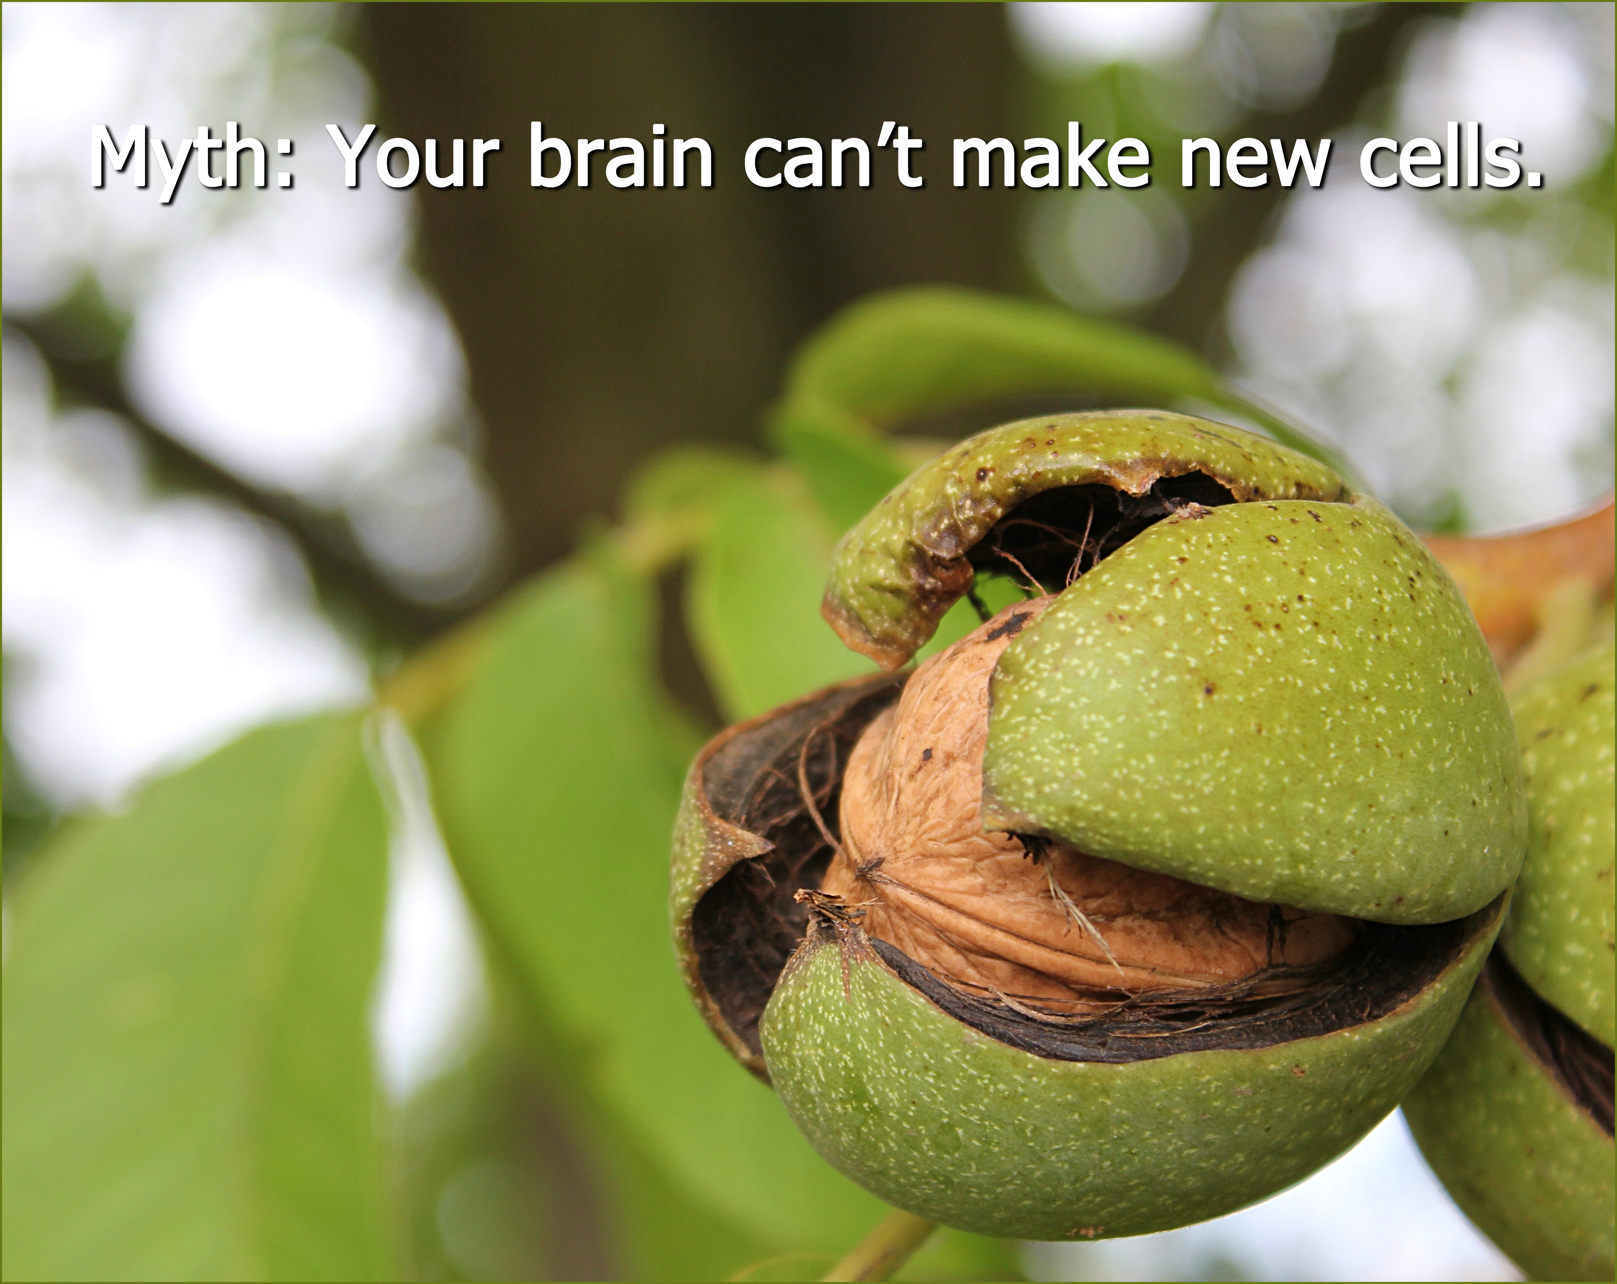
The Power of Mistakes and Struggle
Even when we are completely unaware we are making a mistake…
…the struggle and challenge to generate a wrong answer makes the brain grow.

Slide 14
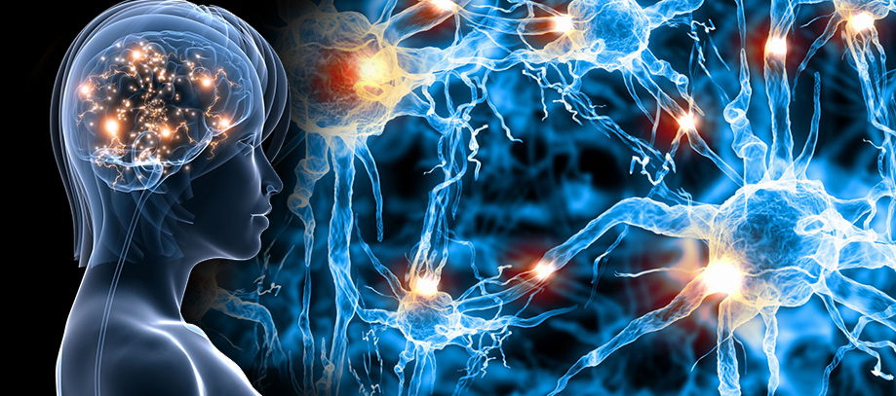
The Power of Mistakes and Struggle
Learners with a growth mindset have MORE electrical activity while making a mistake than those with a fixed mindset.

Slide 15
Having a growth mindset encourages us to revise mistakes… …these revisions produce MORE growth

Slide 16
Having a growth mindset encourages us to revise mistakes… …these revisions produce MORE growth
The opinion we have of ourselves as math learners impacts how much brain growth
we get from our mistakes.

Slide 17
Having a growth mindset encourages us to revise mistakes… …these revisions produce MORE growth
The opinion we have of ourselves as math learners impacts how much brain growth
we get from our mistakes.
We MUST believe in ourselves… ESPESCIALLY during challenging activities.

Slide 18
Fear of Failure prevents action and paralyzes growth… …hardening into rigid perfectionism.
This is the single most disempowering state of mind one can have if one wants to be MORE creative, innovative and entrepreneurial.

Slide 19
Activity 2
Activity 2

Slide 20
ACTIVITY 2
First day of class activity:
Crumple a piece of paper and throw it at the board the way you feel when you are wrong.
Retrieve the paper and smooth it back out .
Trace along all the crumple lines with fine tipped markers.
THIS represents your brain growth when you make mistakes and struggle.
Keep in your folder as a reminder

Slide 21
ACTIVITY 2
First day of class activity:
Crumple a piece of paper and throw it at the board the way you feel when you are wrong.
Retrieve the paper and smooth it back out .
Trace along all the crumple lines with fine tipped markers.
THIS represents your brain growth when you make mistakes and struggle.
Keep in your folder as a reminder

Slide 22
ACTIVITY 2
First day of class activity:
Crumple a piece of paper and throw it at the board the way you feel when you are wrong.
Retrieve the paper and smooth it back out .
Trace along all the crumple lines with fine tipped markers.
THIS represents your brain growth when you make mistakes and struggle.
Keep in your folder as a reminder

Slide 23
ACTIVITY 2
First day of class activity:
Crumple a piece of paper and throw it at the board the way you feel when you are wrong.
Retrieve the paper and smooth it back out .
Trace along all the crumple lines with fine tipped markers.
THIS represents your brain growth when you make mistakes and struggle.
Keep in your folder as a reminder

Slide 24
ACTIVITY 2
First day of class activity:
Crumple a piece of paper and throw it at the board the way you feel when you are wrong.
Retrieve the paper and smooth it back out .
Trace along all the crumple lines with fine tipped markers.
THIS represents your brain growth when you make mistakes and struggle.
Keep in your folder as a reminder

Slide 25
ACTIVITY 2
First day of class activity:
Crumple a piece of paper and throw it at the board the way you feel when you are wrong.
Retrieve the paper and smooth it back out .
Trace along all the crumple lines with fine tipped markers.
THIS represents your brain growth when you make mistakes and struggle.
Keep in your folder as a reminder

Slide 26
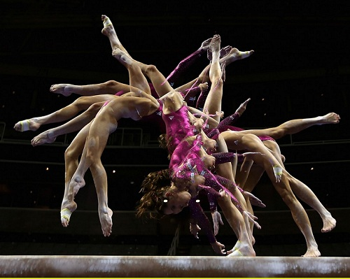
Equilibrium to Disequilibrium
Piaget says when all your concepts fit together, you are in equilibrium.
When something is introduced and processed that makes sense but it does not fit neatly into preconceived equilibrium, you are in disequilibrium.
When you make the connections, and ideas fit together… true learning occurs.
This is essential to learning.

Slide 27
Equilibrium to Disequilibrium
Piaget says when all your concepts fit together, you are in equilibrium.
When something is introduced and processed that makes sense but it does not fit neatly into preconceived equilibrium, you are in disequilibrium.
When you make the connections, and ideas fit together… true learning occurs.
This is essential to learning.

Slide 28
Equilibrium to Disequilibrium
Piaget says when all your concepts fit together, you are in equilibrium.
When something is introduced and processed that makes sense but it does not fit neatly into preconceived equilibrium, you are in disequilibrium.
When you make the connections, and ideas fit together… true learning occurs.
This is essential to learning.

Slide 29
Equilibrium to Disequilibrium
Piaget says when all your concepts fit together, you are in equilibrium.
When something is introduced and processed that makes sense but it does not fit neatly into preconceived equilibrium, you are in disequilibrium.
When you make the connections, and ideas fit together… true learning occurs.
This is essential to learning.

Slide 30
Creativity and Beauty in Math
Math is seen as a performance subject—
…answering questions and taking tests.

Slide 31
Creativity and Beauty in Math
Math is seen as a performance subject—
…answering questions and taking tests.

Slide 32
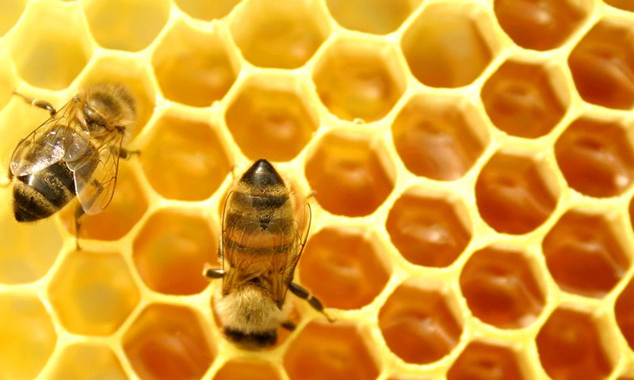
Creativity and Beauty in Math
Math is MUCH more than producing short answers to narrow questions under pressure!

Slide 33
The difference between real math and school math is a wide chasm…
Real math is about patterns and connections.
School math is about facts, rules, calculations and procedures.

Slide 34
Students must be shown math in NATURE as much as math in their “textbook”…
As a science of abstract patterns, there is scarcely any aspect of our lives that is not affected, to a greater or lesser extent, by mathematics; for abstract patterns are the very essence of thought, of communication, of computation, of society, and of life itself.
- Devlin 1997

Slide 36
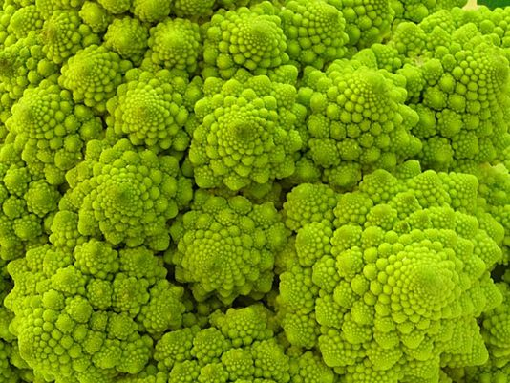

Slide 38
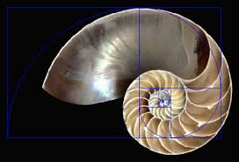

Slide 41
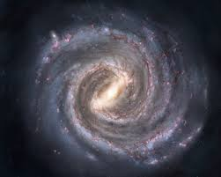

Slide 42
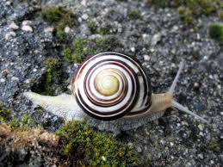

Slide 43
Steps of Exploratory Mathematics:
Ask for (or pose) a question
Go from real world context to a mathematical model
Perform a calculation
Go from the model back to the real world, to see if the original question was answered.

Slide 44
80% of school math class resides in: #3… Perform the Calculation
Companies DO NOT need people to do the calculations.
Math is a discipline… and REASONING is
CENTRAL to the discipline.
Mathematicians prove theories through
reasoning using logical connections.
Mathematics is a SOCIAL subject, and proof comes
only when mathematicians can convince
other mathematicians of logical connections.

Slide 45
We MUST dispel the myth that math is about speed
The powerful thinkers of today are those who make connections, think logically, and use space, data and numbers creatively.

Slide 46
Activity 3
Activity 3

Slide 47
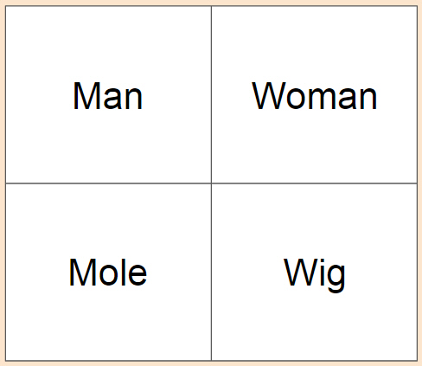
ACTIVITY 3
Which of These DOES NOT Belong?

Slide 48
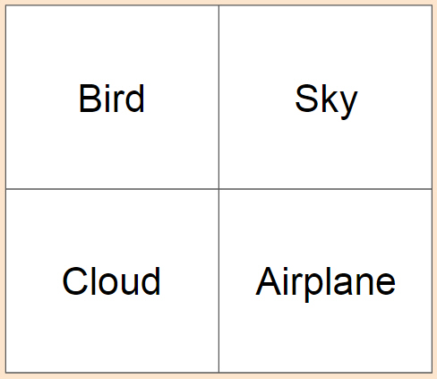
ACTIVITY 3
Which of These DOES NOT Belong?

Slide 49
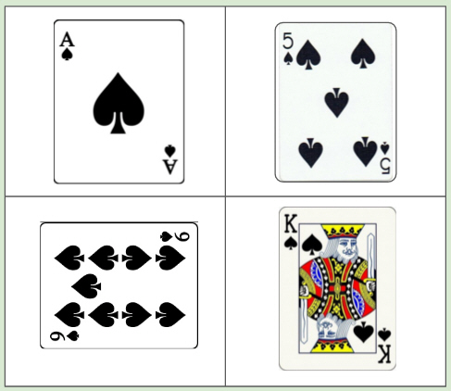
ACTIVITY 3
Which of These DOES NOT Belong?

Slide 50
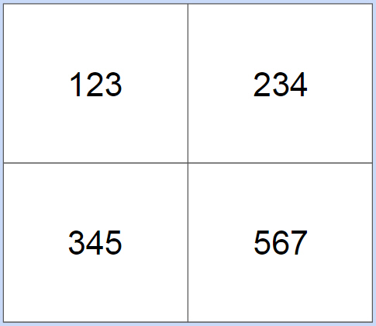
ACTIVITY 3
Which of These DOES NOT Belong?

Slide 51
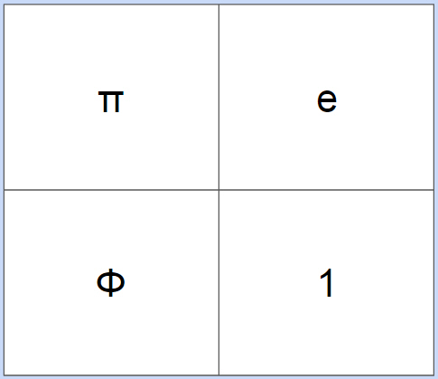
ACTIVITY 3
Which of These DOES NOT Belong?

Slide 52
Creating Math Mindsets: The importance of flexibility with numbers
Smart people say they never move forward with a mathematical model until the situation makes intuitive sense to them.

Slide 53
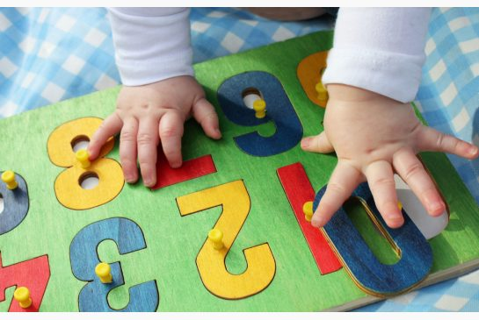
Number Sense
Math mindset and number sense develop together.
Mathematics is very “compressible”
When you learn something new, it takes a LOT of brain space… but once you practice and learn it… it compresses down and is stored.
This storage is easily accessible and usable within other processes when needed.

Slide 54
Number Sense
Math mindset and number sense develop together.
Mathematics is very “compressible”
When you learn something new, it takes a LOT of brain space… but once you practice and learn it… it compresses down and is stored.
This storage is easily accessible and usable within other processes when needed.

Slide 55
Number Sense
Math mindset and number sense develop together.
Mathematics is very “compressible”
When you learn something new, it takes a LOT of brain space… but once you practice and learn it… it compresses down and is stored.
This storage is easily accessible and usable within other processes when needed.

Slide 56
Number Sense
Math mindset and number sense develop together.
Mathematics is very “compressible”
When you learn something new, it takes a LOT of brain space… but once you practice and learn it… it compresses down and is stored.
This storage is easily accessible and usable within other processes when needed.

Slide 57
The Brain Cannot Compress Rules and Procedures
Compression only happens for CONCEPTS so if students do not learn conceptually, they never have this store of COMPRESSED CONCEPTS for them to draw upon…
…Instead they are always working too hard to recall long lists of facts and methods and rules that are taking up loads of brain space….
…Nothing else can get in!
Message: Teach Conceptually

Slide 58
The Brain Cannot Compress Rules and Procedures
Compression only happens for CONCEPTS so if students do not learn conceptually, they never have this store of COMPRESSED CONCEPTS for them to draw upon…
…Instead they are always working too hard to recall long lists of facts and methods and rules that are taking up loads of brain space….
…Nothing else can get in!
Message: Teach Conceptually

Slide 59
The Brain Cannot Compress Rules and Procedures
Compression only happens for CONCEPTS so if students do not learn conceptually, they never have this store of COMPRESSED CONCEPTS for them to draw upon…
…Instead they are always working too hard to recall long lists of facts and methods and rules that are taking up loads of brain space….
…Nothing else can get in!
Message: Teach Conceptually

Slide 60
The Brain Cannot Compress Rules and Procedures
Compression only happens for CONCEPTS so if students do not learn conceptually, they never have this store of COMPRESSED CONCEPTS for them to draw upon…
…Instead they are always working too hard to recall long lists of facts and methods and rules that are taking up loads of brain space….
…Nothing else can get in!
Message: Teach Conceptually

Slide 61
Memorization vs. Understanding
Automaticity should be reached through understanding of numerical relations,
and achieved through thinking
about number strategies.
Remember 12 x 15? ☺

Slide 62
Using both sides of the brain produces more powerful learning
Right brain: is visual and spatial
Left brain: is factual and technical
Formal abstract school math needs to be enhanced by visual and intuitive math thinking.

Slide 63
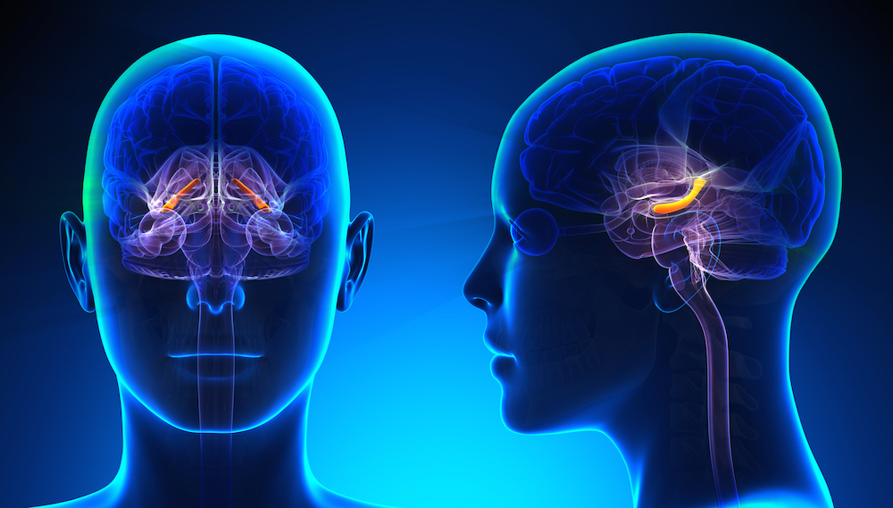
Hippocampus is responsible for memorized facts
The hippocampus can grow over time but it will always be the case that some students are faster than others with their facts.
This has NOTHING to do with
math potential.

Slide 64
Hippocampus is responsible for memorized facts
The hippocampus can grow over time but it will always be the case that some students are faster than others with their facts.
This has NOTHING to do with
math potential.

Slide 65
Hippocampus is responsible for memorized facts
The hippocampus can grow over time but it will always be the case that some students are faster than others with their facts.
This has NOTHING to do with
math potential.

Slide 66
Thinking About It…
We learn to read thousands of words and we also have to learn and know their meaning.
But we would never give a student a timed test on lists of words , asking the student to offer meaning of each one.
Instead, word meaning and recognition are assessed as they are applied to reading, writing, speaking and listening in a CONTEXT.

Slide 67
Thinking About It…
We learn to read thousands of words and we also have to learn and know their meaning.
But we would never give a student a timed test on lists of words , asking the student to offer meaning of each one.
Instead, word meaning and recognition are assessed as they are applied to reading, writing, speaking and listening in a CONTEXT.

Slide 68
Thinking About It…
We learn to read thousands of words and we also have to learn and know their meaning.
But we would never give a student a timed test on lists of words , asking the student to offer meaning of each one.
Instead, word meaning and recognition are assessed as they are applied to reading, writing, speaking and listening in a CONTEXT.

Slide 69
Thinking About It…
We learn to read thousands of words and we also have to learn and know their meaning.
But we would never give a student a timed test on lists of words , asking the student to offer meaning of each one.
Instead, word meaning and recognition are assessed as they are applied to reading, writing, speaking and listening in a CONTEXT.

Slide 70
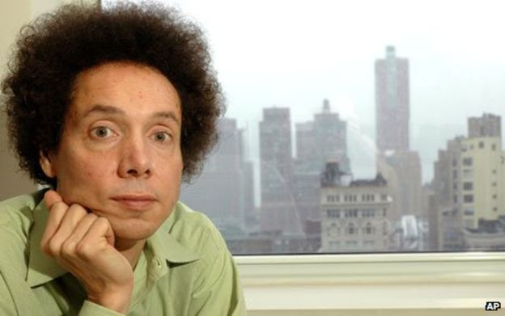
“We need 10,000 hours of practice to
achieve mastery in a field.”
-Gladwell
.

Slide 71
We need 10,000 hours of practice to
achieve mastery in a field - Gladwell
-Gladwell
This does NOT mean 10,000 hours of mindless worksheets that repeat one way of doing math.
It does mean 10,000 hours of on math ideas, connections, solving problems, reasoning and connecting methods.

Slide 72
We need 10,000 hours of practice to
achieve mastery in a field - Gladwell
-Gladwell
This does NOT mean 10,000 hours of mindless worksheets that repeat one way of doing math.
It DOES mean 10,000 hours of on math ideas, connections, solving problems, reasoning and connecting methods.

Slide 73
Repetitive Homework gives a damaging message about the definition of mathematics…

Slide 74
Repetitive Homework gives a damaging message about the definition of mathematics…
Sample effective, reflective homework questions:
What was the main mathematical concepts or ideas that you learned today or that we discussed in class?
Describe a mistake or misconception you or a classmate had today. What did you learn from that mistake?
Describe in detail how someone else in class approached a class problem today. How was it like or unlike your approach?
What was the big mathematical debate about in class today?

Slide 75
Repetitive Homework gives a damaging message about the definition of mathematics…
Sample effective, reflective homework questions:
What was the main mathematical concepts or ideas that you learned today or that we discussed in class?
Describe a mistake or misconception you or a classmate had today. What did you learn from that mistake?
Describe in detail how someone else in class approached a class problem today. How was it like or unlike your approach?
What was the big mathematical debate about in class today?

Slide 76
Repetitive Homework gives a damaging message about the definition of mathematics…
Sample effective, reflective homework questions:
What was the main mathematical concepts or ideas that you learned today or that we discussed in class?
Describe a mistake or misconception you or a classmate had today. What did you learn from that mistake?
Describe in detail how someone else in class approached a class problem today. How was it like or unlike your approach?
What was the big mathematical debate about in class today?

Slide 77
Repetitive Homework gives a damaging message about the definition of mathematics…
Sample effective, reflective homework questions:
What was the main mathematical concepts or ideas that you learned today or that we discussed in class?
Describe a mistake or misconception you or a classmate had today. What did you learn from that mistake?
Describe in detail how someone else in class approached a class problem today. How was it like or unlike your approach?
What was the big mathematical debate about in class today?

Slide 78
Repetitive Homework gives a damaging message about the definition of mathematics…
Sample effective, reflective homework questions:
What was the main mathematical concepts or ideas that you learned today or that we discussed in class?
Describe a mistake or misconception you or a classmate had today. What did you learn from that mistake?
Describe in detail how someone else in class approached a class problem today. How was it like or unlike your approach?
What was the big mathematical debate about in class today?

Slide 79
The 5 C’s of Math Tasks:
Curiosity
Connection-making
Challenge
Creativity
Collaboration

Slide 80
Activity 4
Activity 4

Slide 81
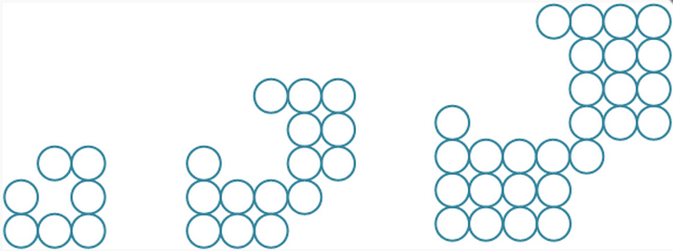
ACTIVITY 4
Look at this pattern silently… Just think about it for a few seconds alone.

Slide 82
ACTIVITY 4
Now on your own DRAW what you THINK the next “stage” should look like...

Slide 83
ACTIVITY 4
How many CIRCLES are in the 4th Stage?

Slide 84
ACTIVITY 4
Now discuss it with your partner(s)

Slide 85
ACTIVITY 4
Now try to PREDICT how many CIRCLES will be in the 10th Stage?

Slide 86
ACTIVITY 4
Can you CREATE an expression or formula for the n^{th} stage?

Slide 87
ACTIVITY 4
I bet you were expecting ME to give you the “CORRECT” answer, weren’t you?
WELL I AM NOT! ☺
How might WE find out if our formula(s) are correct or not?

Slide 88
ACTIVITY 4
Let’s test our formulas… How many CIRCLES in the 43rd Stage?

Slide 89
So what was your consensus?

Slide 90
Engagement in a Model of Multi Dimensional Teaching
Work of the teacher to set up the problem and circulate without hovering
The task itself sufficiently open and challenging to allow different students to contribute ideas
Multidimensionality—differing ways to question, to draw diagrams, make conjectures, work mathematically—to be successful
Request to deal with real world object or idea
High levels of communication amongst students who support each other in questions and explanations.

Slide 91
Engagement in a Model of Multi Dimensional Teaching
Work of the teacher to set up the problem and circulate without hovering
The task itself sufficiently open and challenging to allow different students to contribute ideas
Multidimensionality—differing ways to question, to draw diagrams, make conjectures, work mathematically—to be successful
Request to deal with real world object or idea
High levels of communication amongst students who support each other in questions and explanations.

Slide 92
Engagement in a Model of Multi Dimensional Teaching
Work of the teacher to set up the problem and circulate without hovering
The task itself sufficiently open and challenging to allow different students to contribute ideas
Multidimensionality—differing ways to question, to draw diagrams, make conjectures, work mathematically—to be successful
Request to deal with real world object or idea
High levels of communication amongst students who support each other in questions and explanations.

Slide 93
Engagement in a Model of Multi Dimensional Teaching
Work of the teacher to set up the problem and circulate without hovering
The task itself sufficiently open and challenging to allow different students to contribute ideas
Multidimensionality—differing ways to question, to draw diagrams, make conjectures, work mathematically—to be successful
Request to deal with real world object or idea
High levels of communication amongst students who support each other in questions and explanations.

Slide 94
Engagement in a Model of Multi Dimensional Teaching
Work of the teacher to set up the problem and circulate without hovering
The task itself sufficiently open and challenging to allow different students to contribute ideas
Multidimensionality—differing ways to question, to draw diagrams, make conjectures, work mathematically—to be successful
Request to deal with real world object or idea
High levels of communication amongst students who support each other in questions and explanations.

Slide 95
Engagement in a Model of Multi Dimensional Teaching
Work of the teacher to set up the problem and circulate without hovering
The task itself sufficiently open and challenging to allow different students to contribute ideas
Multidimensionality—differing ways to question, to draw diagrams, make conjectures, work mathematically—to be successful
Request to deal with real world object or idea
High levels of communication amongst students who support each other in questions and explanations.

Slide 96
Class Norms to Encourage Math

Slide 97
Class Norms to Encourage Math
Everyone can learn math to the highest levels.
Mistakes are valuable
Questions are really important
Math is about creativity and making sense
Math is about connections and communicating
Depth is much more important than speed
Math class is about learning not performing
Notes:
Railside spent the first 10 weeks of highschool learning these norms without the hard content.

Slide 98
Class Norms to Encourage Math
Everyone can learn math to the highest levels.
Mistakes are valuable
Questions are really important
Math is about creativity and making sense
Math is about connections and communicating
Depth is much more important than speed
Math class is about learning not performing
Notes:
Railside spent the first 10 weeks of highschool learning these norms without the hard content.

Slide 99
Class Norms to Encourage Math
Everyone can learn math to the highest levels.
Mistakes are valuable
Questions are really important
Math is about creativity and making sense
Math is about connections and communicating
Depth is much more important than speed
Math class is about learning not performing
Notes:
Railside spent the first 10 weeks of highschool learning these norms without the hard content.

Slide 100
Class Norms to Encourage Math
Everyone can learn math to the highest levels.
Mistakes are valuable
Questions are really important
Math is about creativity and making sense
Math is about connections and communicating
Depth is much more important than speed
Math class is about learning not performing
Notes:
Railside spent the first 10 weeks of highschool learning these norms without the hard content.

Slide 101
Class Norms to Encourage Math
Everyone can learn math to the highest levels.
Mistakes are valuable
Questions are really important
Math is about creativity and making sense
Math is about connections and communicating
Depth is much more important than speed
Math class is about learning not performing
Notes:
Railside spent the first 10 weeks of highschool learning these norms without the hard content.

Slide 102
Class Norms to Encourage Math
Everyone can learn math to the highest levels.
Mistakes are valuable
Questions are really important
Math is about creativity and making sense
Math is about connections and communicating
Depth is much more important than speed
Math class is about learning not performing
Notes:
Railside spent the first 10 weeks of highschool learning these norms without the hard content.

Slide 103
Class Norms to Encourage Math
Everyone can learn math to the highest levels.
Mistakes are valuable
Questions are really important
Math is about creativity and making sense
Math is about connections and communicating
Depth is much more important than speed
Math class is about learning not performing
Notes:
Railside spent the first 10 weeks of highschool learning these norms without the hard content.

Slide 104
Activity 5
Activity 5
Alternative Activities:
www.DrTaylorMathCoach.com

Slide 105
ACTIVITY 5
Look at this pattern silently… Just think about it for a few seconds alone.

Slide 106
ACTIVITY 5
Look at this pattern silently… Just think about it for a few seconds alone.
Describe what you see as completely as possible in your mind.
Write a bullet list of your observations.
When asked… We shall share out our observations together.

Slide 107
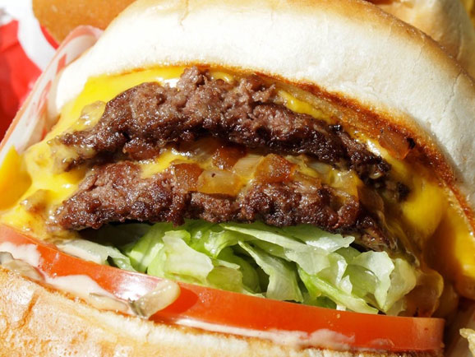
ACTIVITY 5
Now what do you notice...Speak with your partner(s)

Slide 108
ACTIVITY 5
In-N-Out ordinarily sells hamburgers, cheeseburgers, and Double-Doubles. Double-Doubles are comprised of 2 beef patties, 2 slices of cheese, one “bun” (split) and one “produce” (lettuce, tomato, onion, etc…). In-N-Out has a very small and simple menu… but they also have a SECRET MENU!

Slide 109
ACTIVITY 5
In-N-Out ordinarily sells hamburgers, cheeseburgers, and Double-Doubles.
Double-Doubles are comprised of 2 beef patties, 2 slices of cheese, one “bun” (split) and one “produce” (lettuce, tomato, onion, etc…). In-N-Out has a very small and simple menu… but they also have a SECRET MENU!

Slide 110
ACTIVITY 5
In-N-Out ordinarily sells hamburgers, cheeseburgers, and Double-Doubles.
Double-Doubles are comprised of 2 beef patties, 2 slices of cheese, one “bun” (split) and one “produce” (lettuce, tomato, onion, etc…). In-N-Out has a very small and simple menu… but they also have a SECRET MENU!

Slide 111
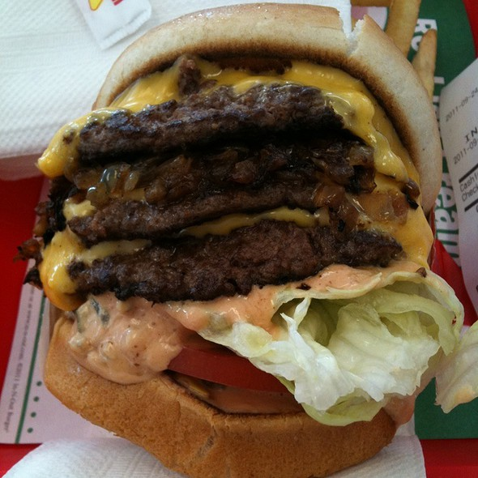
ACTIVITY 5
This is a “Triple-Triple”… Your task is to determine the price.
OK GO!

Slide 112
ACTIVITY 5
What’s the problem?
Make a list of what you feel you need:

Slide 113
ACTIVITY 5
What’s the problem?
- What is a price that would be TOO LOW?
- What is a price that would be TOO HIGH?
- What are the differences between a cheeseburger and a Double-Double?

Slide 114
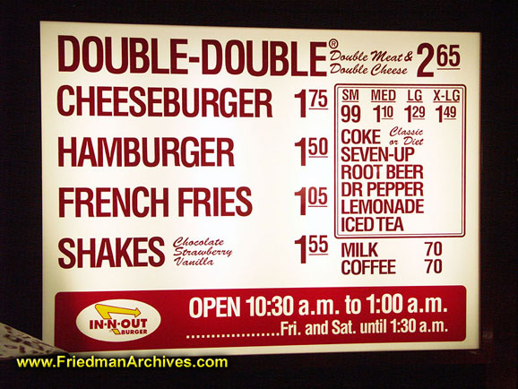
ACTIVITY 5
What’s the COST of a 3x3 burger? Ignore Tax

Slide 115
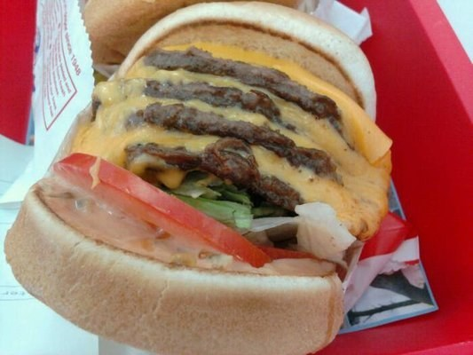
ACTIVITY 5
What’s the COST of a 4x4 burger? Ignore Tax

Slide 116
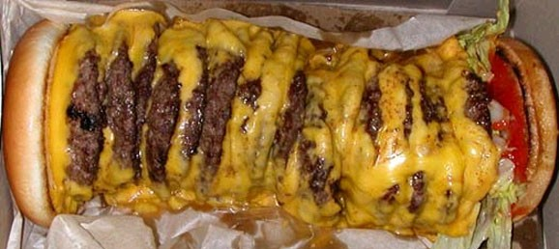
ACTIVITY 5
What’s the COST of a 20x20 burger? Ignore Tax

Slide 117
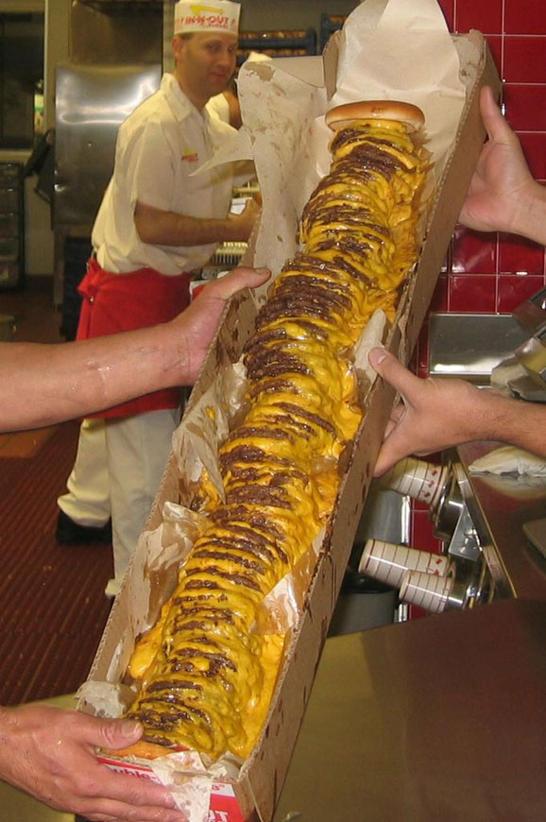
ACTIVITY 5
What’s the COST of a 100x100 burger… Ignore tax

Slide 118
ACTIVITY 5
Create a FORMULA for a
nxn Burger!

Slide 119
ACTIVITY 5
TEST your FORMULA for the
nxn Burger!

Slide 120
Value Struggle and Failure
Resist praising effortless achievement
Avoid the achievement culture in math class
Teach how to struggle and grow from it

Slide 121
Connections Video
Eight years of math connected to demonstrate that math is a study of connections and patterns.
http://www.youcubed.org/tour-of-mathematical-connections/
Check It Out!

Slide 122
References and Resources:
Thank You
Mathematical Mindset - Jo Boaler
https://www.youcubed.org/
www.DrTaylorMathCoach.com

Slide 123
Photos and Clip Art: In order of appearance…
http://www.nsf.gov/news/mmg/media/images/open_brain1_f.jpg
http://blogs.psychcentral.com/mindful-mastery/files/2015/12/PerfectionFrustration.jpg
https://maddykendall.files.wordpress.com/2014/02/math-problem-solving.jpg
http://epilepsyu.com/wp-content/uploads/2014/07/synapse.jpg
http://themindbodyshift.com/wp-content/uploads/2015/07/10-Ways-We-Can-Love-Our-Brains-to-Keep-Us-Mentally-Sharp-As-We-Age.jpg
http://www.brainwavebc.com/images/brain-training-retreat.jpg
http://tri_trinit_23044.blogs.propertysolutions.com/wp-content/files/2013/07/self-improvement-training.jpg
https://kavliblog.files.wordpress.com/2014/12/human-brain-art.jpg
https://howtostopcomforteating.com/wp-content/uploads/2015/07/iStock_000011665739XSmall-347x315.jpg
http://www.designmom.com/wp-content/uploads/2012/08/gymnastics-b.jpg
http://static2.businessinsider.com/image/5541483eecad046d50e17bdf-3000-2156/1321884.jpg
https://deae89a72d2f97fc67dc-8512833177f375bfc9e117209d1deddc.ssl.cf2.rackcdn.com/bzPlIEBdJm_1401657036629.jpg?rasterSignature=71257a005ca1073318cac43d931d24bf&theme=Five%20Seven%20Five&imageFilter=false
http://www.gannett-cdn.com/-mm-/327e739a4e3333fefda6eb18bd7f4c61880d4807/c=58-0-966-681&r=x404&c=534x401/local/-/media/Binghamton/2014/11/19/lcr4.jpg

Slide 124
Photos and Clip Art: In order of appearance…
http://www.healthnewsline.net/wp-content/uploads/2013/10/Baby%E2%80%99s-innate-number-sense-foretells-future-math-skill.jpeg
https://www.psychologie.hu-berlin.de/en/images/numbersense/image_preview
https://www.youcubed.org/wp-content/uploads/2015/09/hippocampus1.jpg
http://searchenginewatch.com/IMG/167/288167/new-thinking-320x320.jpg?1449676050
http://ichef.bbci.co.uk/news/624/media/images/73291000/jpg/_73291477_gladwell_ap464.jpg
https://execusensoryandneuropedagogy.files.wordpress.com/2015/02/homework.jpg?w=484
www.DrTaylorMathCoach.com
http://jesusgilhernandez.com/wp-content/uploads/2015/01/summarize-group-consensus-after-each-decision-point-during-a-meeting.jpg
http://thephilanews.s3.amazonaws.com/wp-content/uploads/2011/06/Beating-Corruption-by-Building-Consensus-459x240.jpg
http://advantureconsulting.com/wp-content/uploads/2013/04/Team-Consensus.jpg
https://docs.google.com/presentation/d/1HLiaLnozfy3r0bIF83uoKJbod6ZBB7FYLiH7edAgaZ4/edit#slide=id.g647166b69_0_151

